Slide 1
UF & Microsoft
Strategic Partnership Meeting

Slide 2
Enterprise
Forefront Security Suite: Client Security, Exchange Security, Online Protection for Exchange , SharePoint Security, Office Communication Server Security, Threat Management Gateway, Unified Access Gateway
System Center Client Suite
DPM, Service Manager
Exchange Ent CAL
(Archiving, Unified messaging, Compliance)
Office SharePoint Ent CAL
(E-forms, Spreadsheet publishing, Data integration, FAST, Performance Point)
Lync Standard
Lync Enterprise CALs
(IM, Conferencing)
Enterprise
CALs
Windows Rights Mgmt Services CAL
Standard
CALs
Windows Server CAL
(Workload, File and Print, WSS, AD)
SCCM
(Monitoring and Updates)
Exchange Std CAL
(Messaging, Calendar, Contacts)
Office SharePoint Std CAL
(ECM, Portal, Search)
Exchange Server
(Std or Ent)
Office SharePoint Server
External Connectors/ MOSSFIS
Config Man Server ML Std/Ent.
Servers
Windows Server
Key
Software to run hardware
Core CAL Suite component
Enterprise CAL Suite component

Slide 3
Student Option
Students have:
Windows 7 Upgrade
Office 2010 or Mac Office 2011
Includes VDI rights for UF Students
Students keep a perpetual license when they graduate

Slide 4
Core Server Platform
Windows Server – All Editions
SharePoint Server – All Editions
Exchange Server – All Editions
System Center Configuration Manager
External Connectors: Windows, SharePoint, Exchange
System Center Configuration Manager Management License (Standard and Enterprise)
Microsoft Office SharePoint Server for Internet Sites

Slide 5
Office 2010 Features

Slide 6
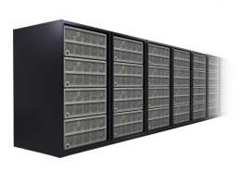
Core Design Tenets
High Fidelity
Familiar Office Experience
Hosting Options
Round Tripping
Best Productivity Experience Across PC, Phone, Browser
IT Choice and Value
Online Service
On-Premises
Unified Communications
Business Intelligence
Enterprise Content Management
Collaboration
Enterprise Search
Unified Business Platform

Slide 7
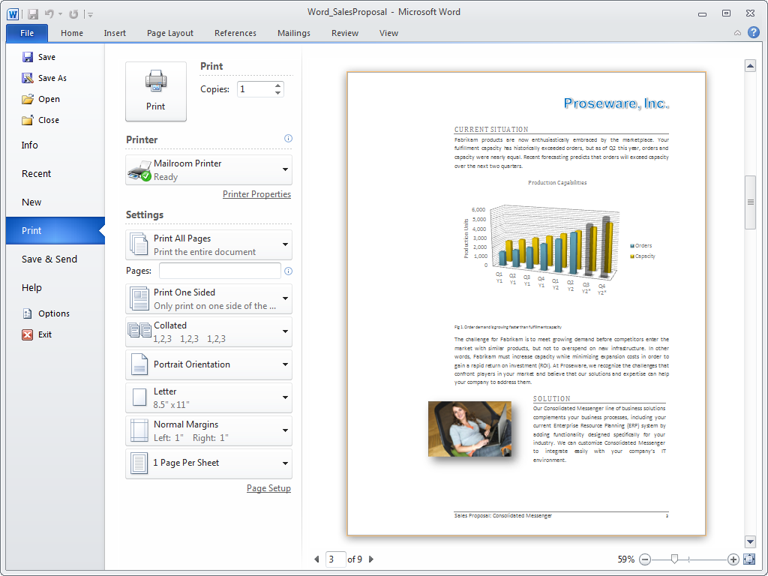
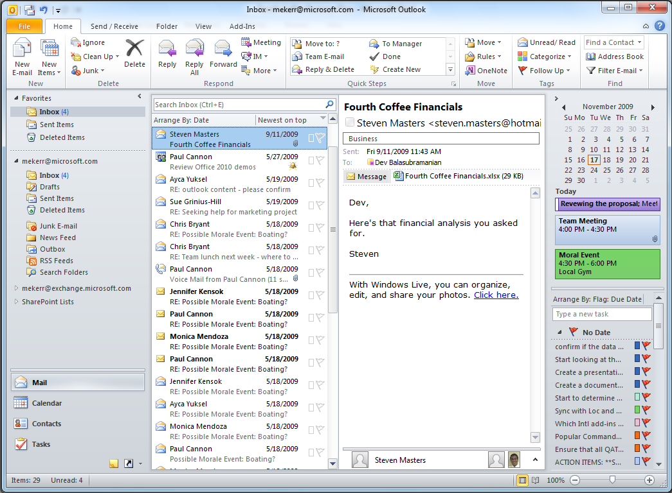
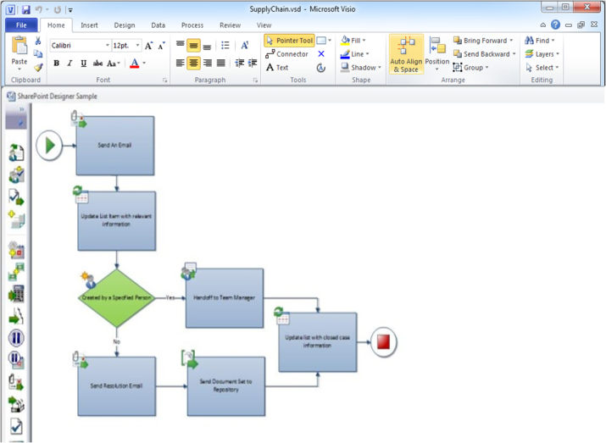
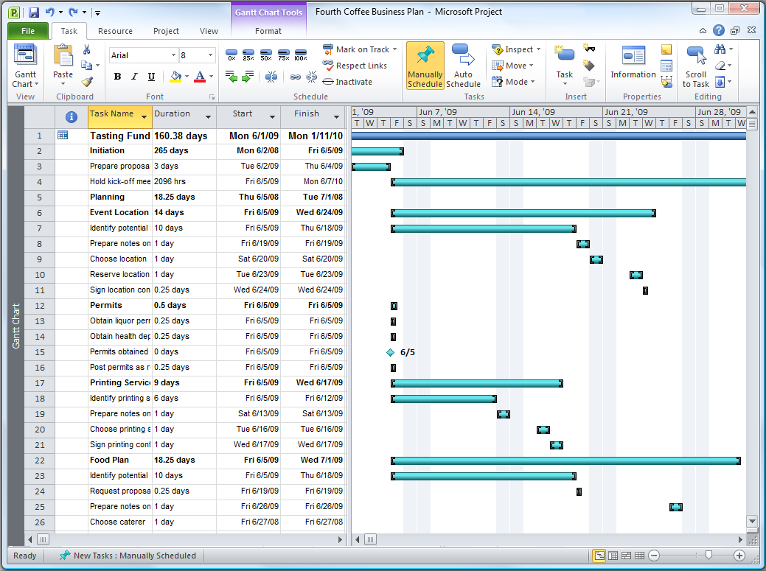
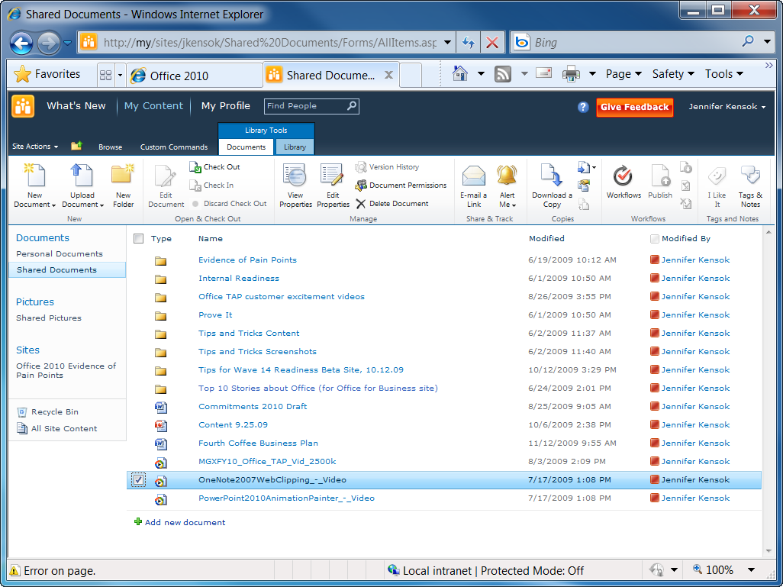
New Commands Make Everyone More Productive Everyone Finds Them with the Ribbon Toolbar and Backstage view
Fuel adoption with a contextual,
seamless look & feel from the rich
client applications to the browser
Improved Printing Experience
Outlook®
SharePoint Workspace
Customizable & Extensible
Visio
Project
SharePoint®
Connect to Services

Slide 8
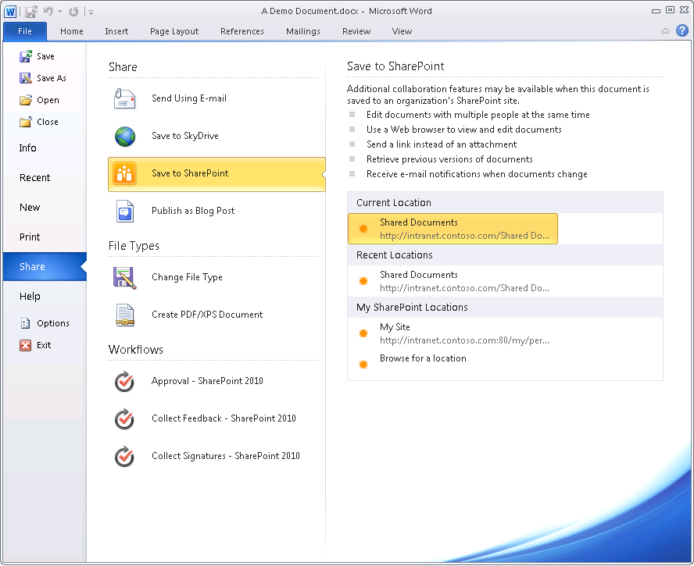
Backstage

Slide 9
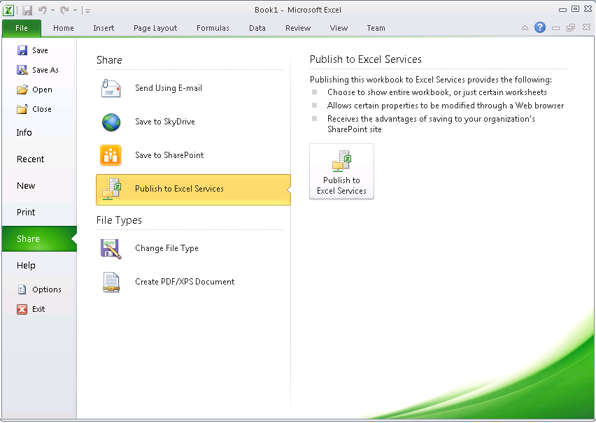
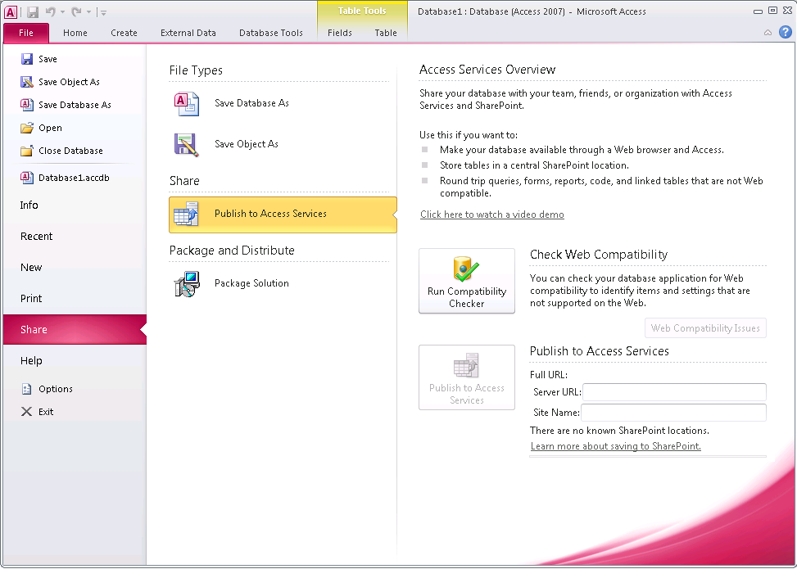
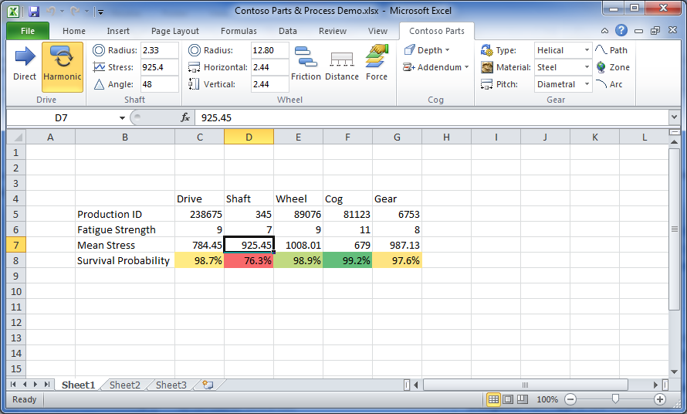
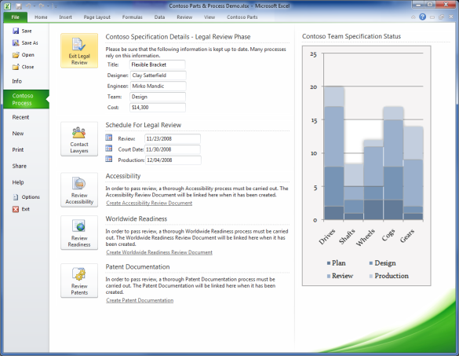
Service Connections

Slide 10
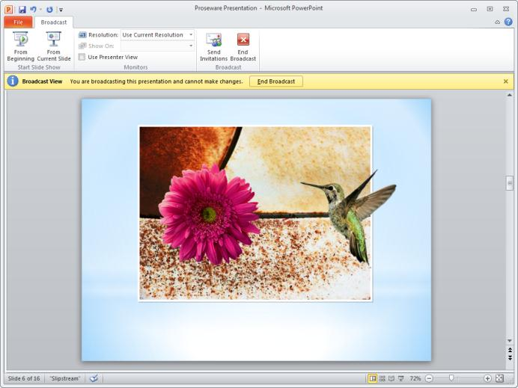
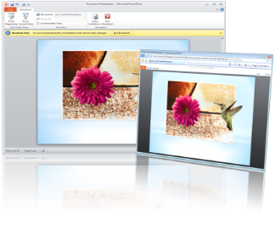
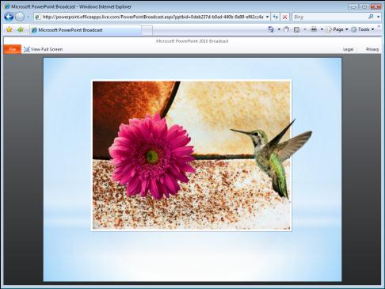
Share a Presentation with Others Instantly Using Broadcast Slide Show in PowerPoint 2010
Work Better Together
Host on SharePoint or free internet service
Appearance to presenter on the PC
Challenge: It is cumbersome to set up a virtual presentation for people outside your own organization.
Broadcast Slide Show: Present a slideshow directly from PowerPoint to anyone who can access a Web browser. Send an e-mail invitation with a web link and the recipient can follow along in their browser while you control the presentation from your PC.
Potential savings/efficiency gains: Hold spontaneous meetings without the added expense or effort of third-party broadcasting tools.
IT can keep security in mind by managing through Group Policy and choose between a broadcast service hosted locally on SharePoint 2010 with the Web Apps, a free service provided over the Internet, or both.
PowerPoint Broadcast (Click Image)
Appearance to viewers through the browser

Slide 11
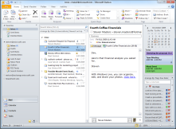
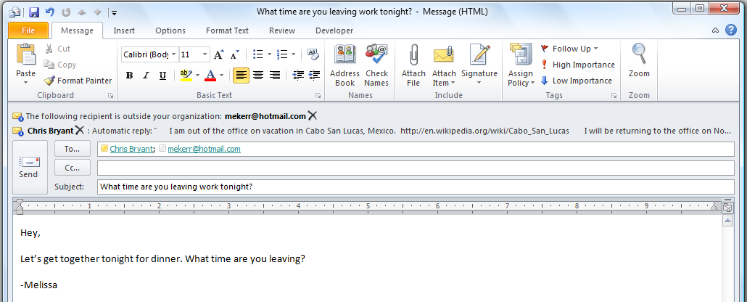
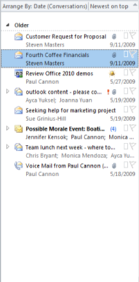
Take Control of Your E-mail and Calendar With New Shortcuts and Views in Outlook 2010
Ignore and Clean Up
Work Better Together
Challenge: The average worker receives large volumes of e-mail every day, making it time consuming to stay organized and up-do-date and find information when it’s needed.
Conversation View
(click to change view)
New Conversation Management Tools: Conversation View, Clean Up, and Ignore remove duplicate information and act like a mute button for the inbox. Mail Tips provide notification before sending to a group or individual outside the organization, a large distribution list, someone who is out of office, etc.
MailTips
Shrink your inbox
Conversation View (Click Image)
Potential savings/efficiency gains: Spend less time wading through e-mail and more time on value-add activities.
IT can worry less about information leakages since Mail Tips help to prevent them.
Click here to minimize
MailTips (Click Image)

Slide 12
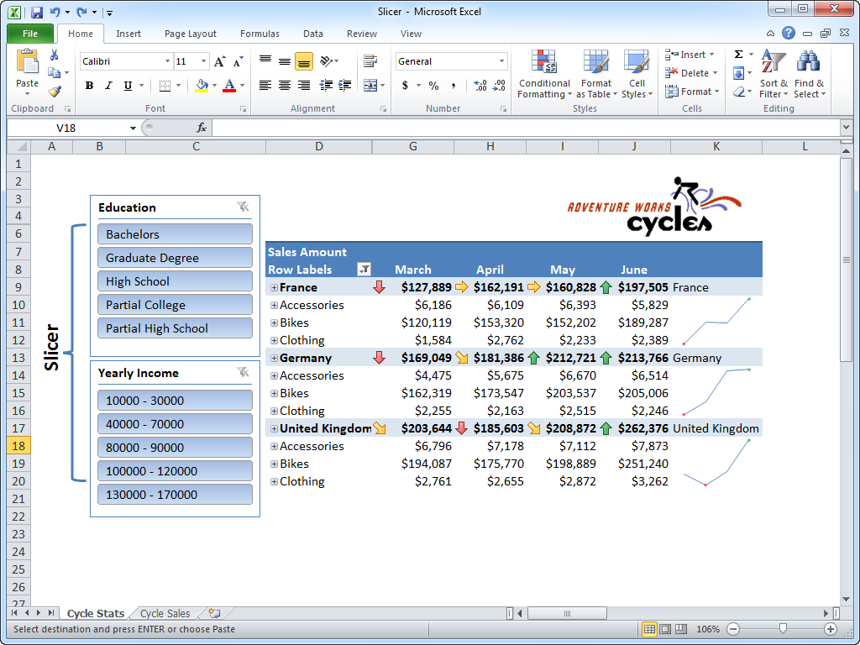
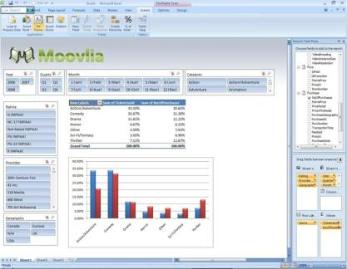
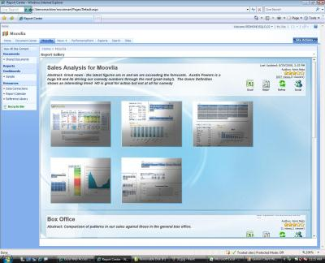
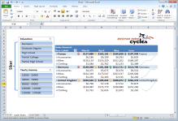
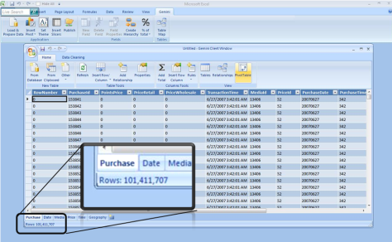
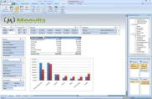
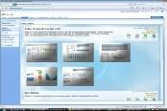
Make Fast, Effective Comparisons from Lists of Data By Using PowerPivot for Excel and New Tools to Visualize Data
Bring Ideas to Life
Challenge: Large volumes of data can be slow and cumbersome to analyze.
Slicers
Self Service analysis delivered thru Excel & Slicers
New conditional formatting icons
New data analysis tools: PowerPivot for Excel provides lighting fast query and sorting capabilities with hundreds of million of records. Sparklines convey trends for a string of numbers in a single cell.
Improved SharePoint interoperability
Sparklines and Conditional Formatting (Click Image)
Potential savings/efficiency gains: Rich data analysis is more easily accessible to more people and can eliminate the need to buy Business Intelligence software that can be costly or difficult to learn to use. Saves time identifying business trends.
Sparklines
Work with massive amounts of data
PowerPivot for Excel Add-in (Click Image)

Slide 13
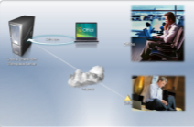
Work with SharePoint Documents and Lists Offline With SharePoint Workspace 2010
Use Office Anywhere
Select content to take offline
Challenge: Trends toward working remotely have lead to high demand for a seamless online/offline experience.
Auto-sync
Auto-sync
Offline
SharePoint Workspace: Take SharePoint libraries and lists offline by simply pointing at a site or from the SharePoint site itself. When you reconnect, only the changes are synchronized, providing fast updates even over a low bandwidth connection.
SharePoint Workspace (Click Image)
SharePoint Workspace Server
Efficient sync of changes only
Potential savings/efficiency gains: Make more of existing SharePoint investments by enabling people to stay productive and in sync when away from the office.
IT can drive uptake of SharePoint initiatives by delivering a rich experience for access to content, online or offline, with integrated authentication.
Integrated to local desktop search
Delta
SharePoint Offline Scenario (Click Image)
Taking SharePoint Offline

Slide 14
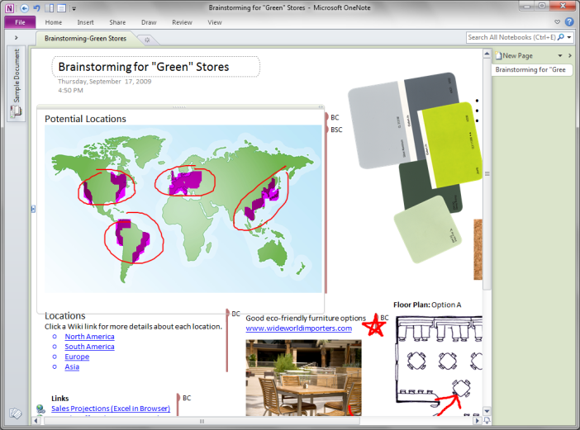
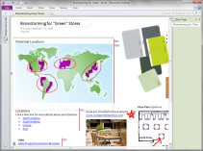
Find the Best Ideas with One Canvas for Brainstorming Combine Information from Multiple People with OneNote 2010
Work Better Together
Challenge: It’s difficult to hold brainstorm sessions with a group spread across multiple locations.
Author indicators
New capability: Author indicators and improved version tracking
Capability description: See who else is currently in a notebook and what they are changing with author indicators.
Get a clear view of what has changed since you last opened a notebook with easy-to-follow version history.
OneNote with Indicators (Click Image)
Potential savings/efficiency gains: Share all kinds of information without wasting inbox space, money or trees.

Slide 15
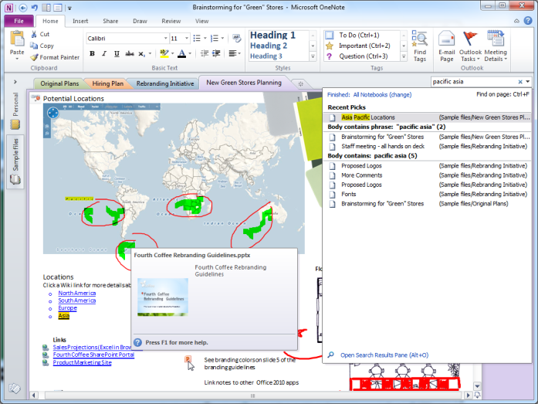
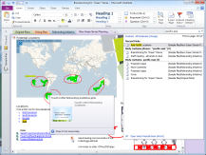
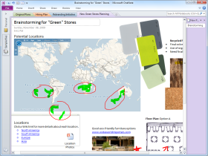
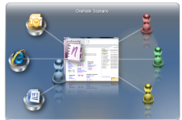
Keep the Right Details in the Right place By Capturing and Searching All Types of Content with OneNote 2010
Bring Ideas to Life
OneNote Scenario
Challenge: People are using more types of digital content and larger volumes of data, which can lead to information overload and time wasted searching.
Ad-hoc project
Insert many types of content
New capability: Improved search pane & new side notes
Capability description: The results pane provides more context around search matches to help you find information more quickly.
Creating “side notes” from other applications will link back to OneNote.
OneNote (Click Image)
Search results pane for better visibility, navigation
Potential savings/efficiency gains: Using OneNote 2007, Pfizer has reduced time to market by 2 months by using OneNote as the primary knowledge sharing vehicle in their drug development labs worldwide.
Single location for quick access
Create linked notes while working in other apps
OneNote Scenario (Click Image)
Multiple sources
Shareable with co-workers

Slide 16
Highlighted Servers

Slide 17
Ribbon UI
SharePoint Workspace
SharePoint Mobile
Office Client and Office Web App Integration
Standards Support
Business Connectivity Services
InfoPath Form Services
External Lists
Workflow
SharePoint Designer
Visual Studio
API Enhancements
REST/ATOM/RSS
Tagging, Tag Cloud, Ratings
Social Bookmarking
Blogs and Wikis
My Sites
Activity Feeds
Profiles and Expertise
Org Browser
Sites
Composites
Communities
Insights
Content
Enterprise Content Types
Metadata and Navigation
Document Sets
Multi-stage Disposition
Audio and Video Content Types
Remote Blob Storage
List Enhancements
PerformancePoint Services
Excel Services
Chart Web Part
Visio Services
Web Analytics
SQL Server Integration
PowerPivot
Search
Social Relevance
Phonetic Search
Navigation
FAST Integration
Enhanced Pipeline

Slide 18
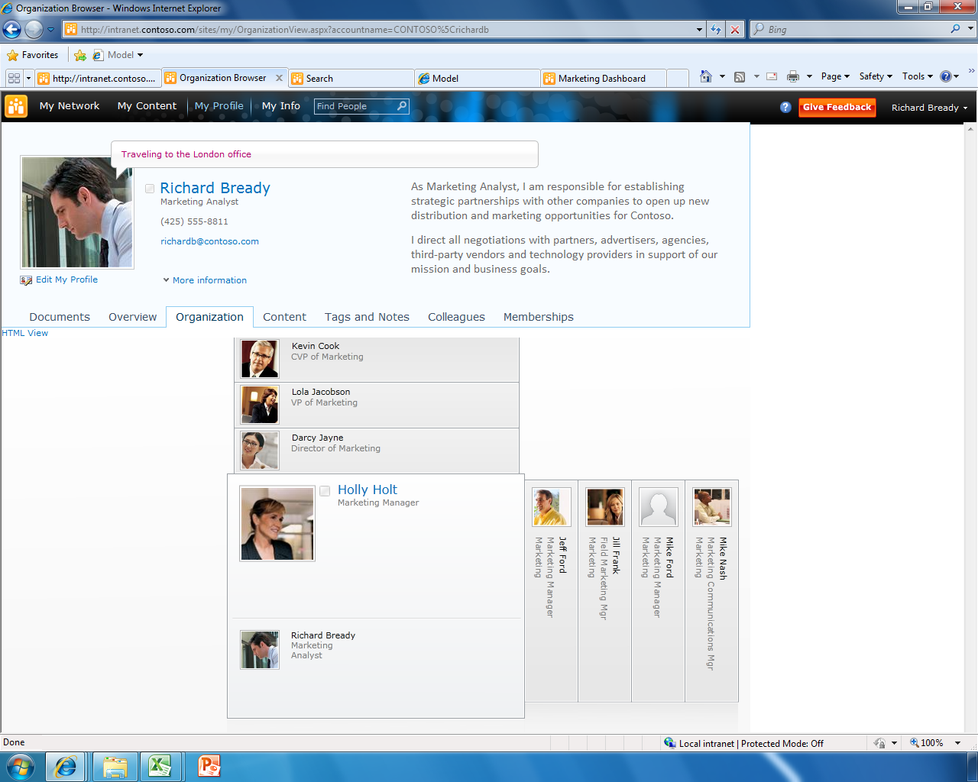
SharePoint Communities
Informal Knowledge
Social Connections
Participation Anywhere
Browse People Directory
Search by Expertise and Profile
Define Your Colleagues
Comments & Presence
Tag-Cloud Navigation
Content Rating
Rich Blog Experience
Enterprise Social Computing Platform

Slide 19
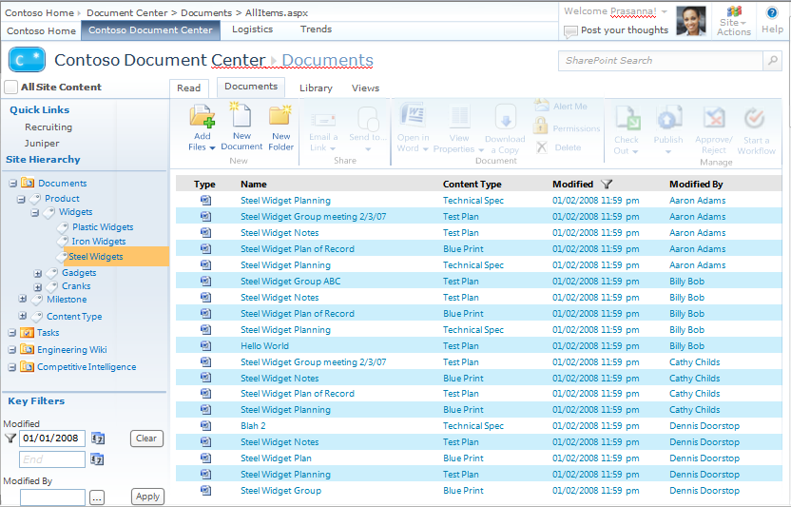
SharePoint Content
User-Centric
Flexibility and Compliance
Management Efficiency
Different Types of Content Items
Capture Meta-data within the Office client
Manage Content as a Single Entity
Hierarchical Taxonomy Structure
Meta-driven Navigation
Manage All Content from Creation through Disposition

Slide 20
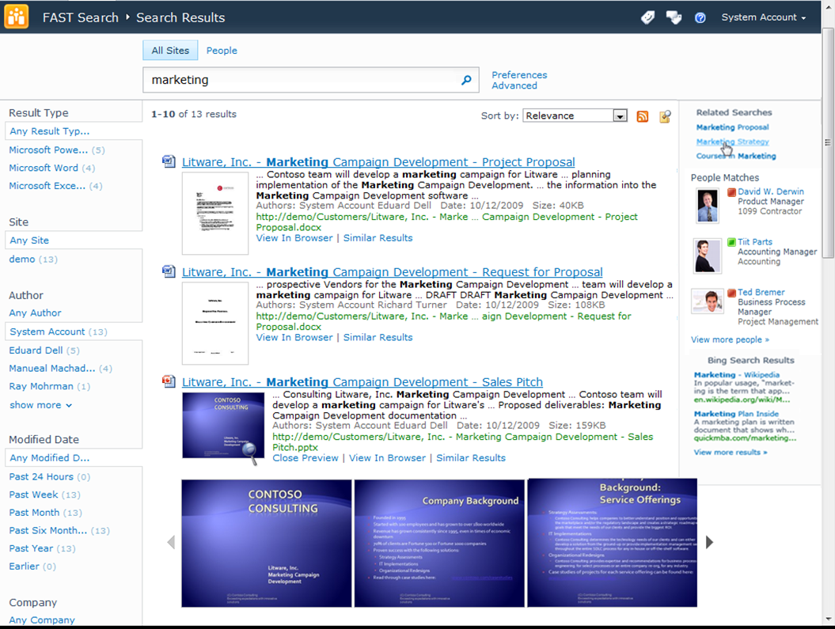
SharePoint Search
Better Answers, Faster
Knowledge Amplification
Enterprise Deployment
Standard & FAST Search
Relevance Enhanced by User Tagging & Rating
Navigators with Exact Counts
Recent Content
Document Previews and Thumbnails
People Search with Phonetic Name Lookup and Wildcards

Slide 21
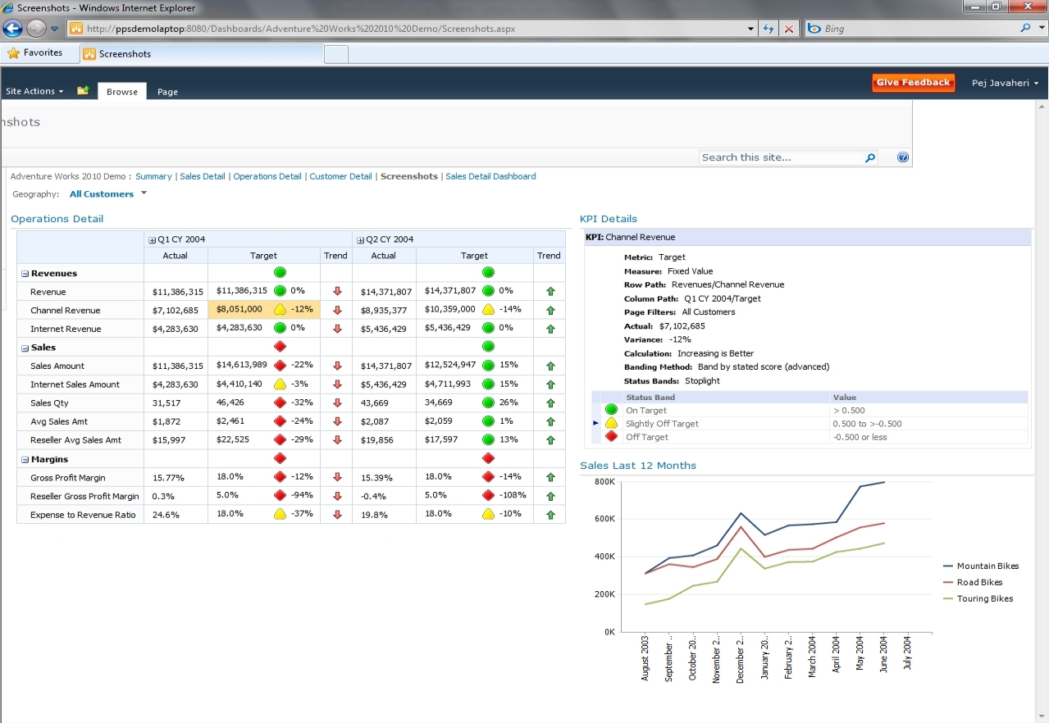
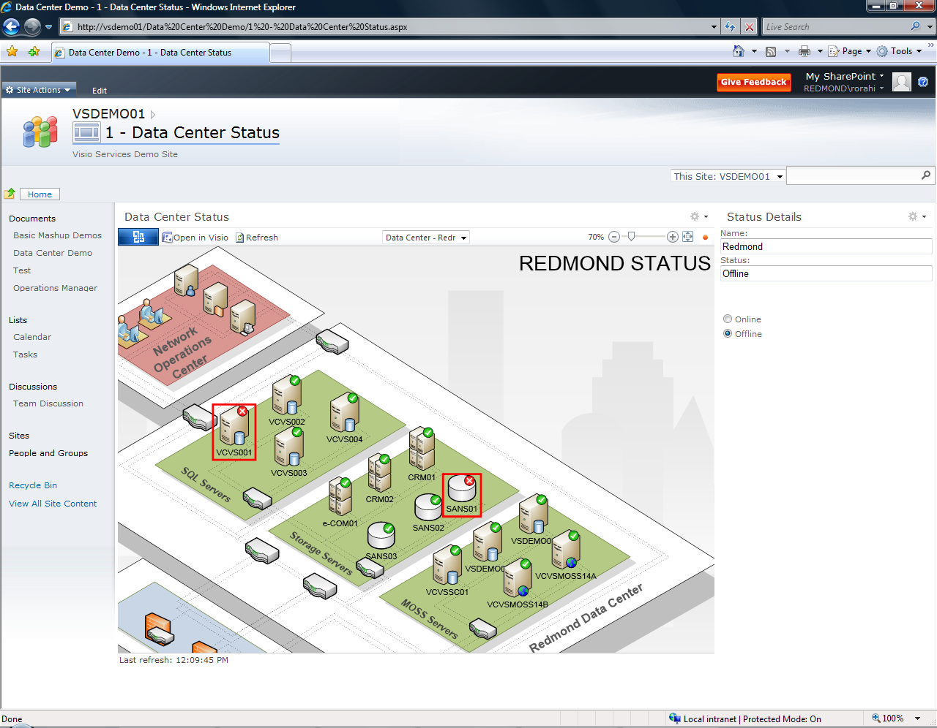
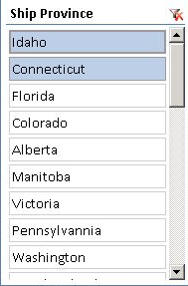
SharePoint Insights
Data Interaction
Decision Making
Organizational Effectiveness
Dashboards and Heat Maps
Interactive PivotTables
Visual Scorecards with Detailed KPIs
Excel Services, Visio Services
Real-time Visual Data with Connectivity to any Data Source

Slide 22
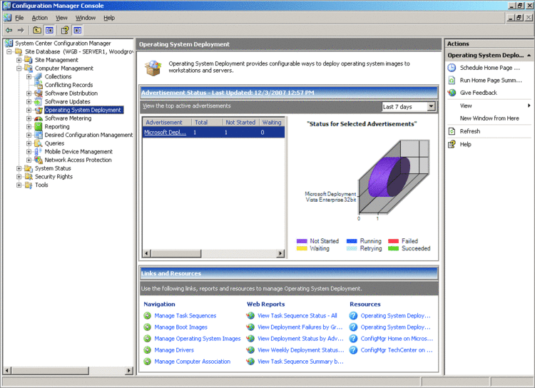
ConfigMan
Zero-Touch OS Deployment
Bare-metal and Upgrades
Application Deployment
Physical and Virtual
Application and OS Updating
Advanced Remote Control
Desired Configuration Management
Asset Intelligence and Software Metering
Power Management & Reporting for Windows client
Intel vPro Integration

Slide 23
Unified Protection
Integrated real-time anti-virus/spyware
Advanced malware protection
Backed by MSRC
Simplified Administration
One policy definition to manage all agents
Push definition updates using MU or WSUS
Integrates with your existing infrastructure
Visibility and Control
State assessment scans and security alerts
Customizable alerts

Slide 24
Forefront server security solutions help businesses protect their messaging and collaboration servers against viruses, worms, spam and inappropriate content.
Multiple scan engines at multiple layers throughout the corporate infrastructure provide maximum protection against e-mail and collaboration threats
Comprehensive Protection
Optimized Performance
Tight integration with Microsoft Exchange, SharePoint and Office Communications Servers maximizes availability and performance
Simplified Management
Easy-to-use management console provides central configuration and operation, automated scan engine signature updates and reporting at the server and enterprise level

Slide 25
Thank You
Product Lifecycle & End of Life Information
www.microsoft.com/lifecycle
© 2010 Microsoft Corporation. All rights reserved. Microsoft, Windows, Windows Vista and other product names are or may be registered trademarks and/or trademarks in the U.S. and/or other countries. The information herein is for informational purposes only and represents the current view of Microsoft Corporation as of the date of this presentation. Because Microsoft must respond to changing market conditions, it should not be interpreted to be a commitment on the part of Microsoft, and Microsoft cannot guarantee the accuracy of any information provided after the date of this presentation. MICROSOFT MAKES NO WARRANTIES, EXPRESS, IMPLIED OR STATUTORY, AS TO THE INFORMATION IN THIS PRESENTATION.

